Slide 1
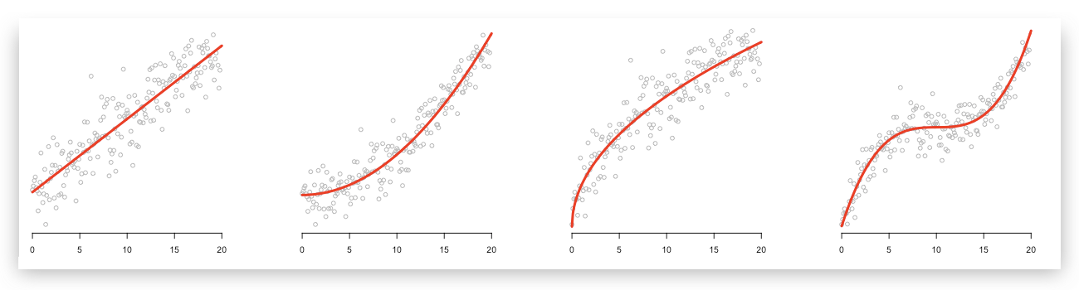
Linear regression and linear models

Slide 2
What is linear regression?
Find a linear relationship between an observation variable and an explanatory variable

Slide 3
What is linear regression?
Find linear relationships between an observation variable and several explanatory variables
Allow us to make predictions at new locations (forecasting and decision making)
Allow us to distinguish between models (model structure / understanding the system)

Slide 4
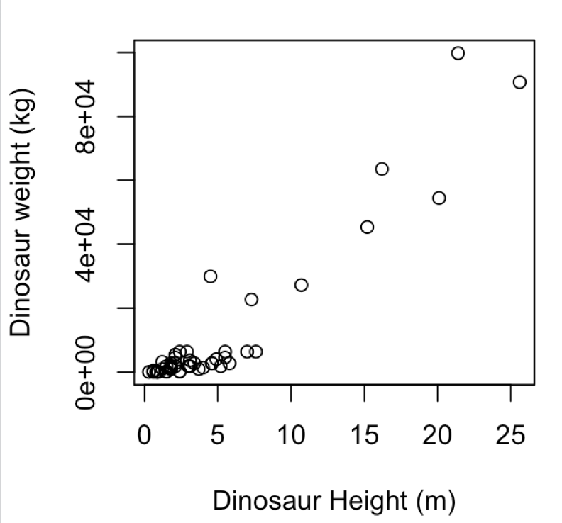
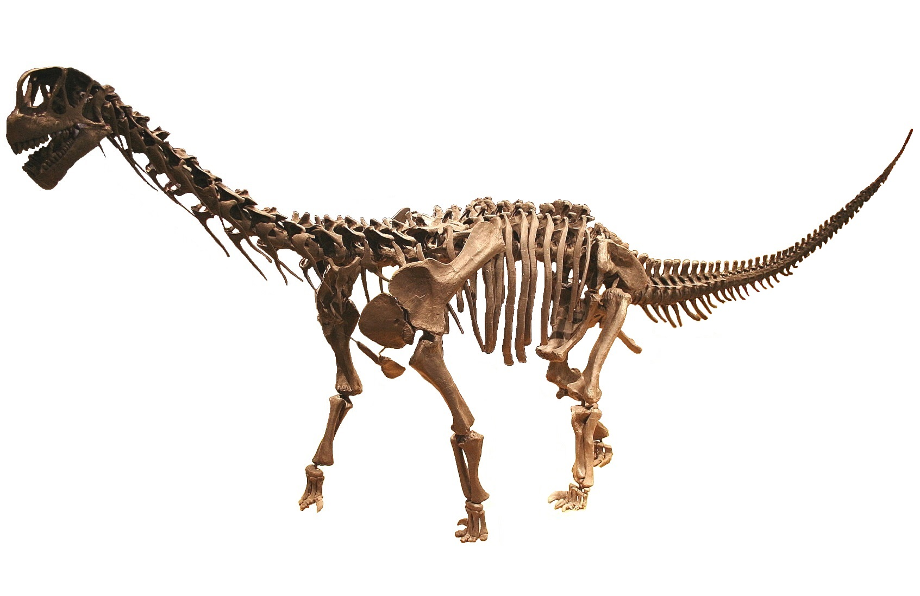
What is linear regression?
Find a relationship between a dinosaur’s height and and weight
Both the observation variable and the explanatory variables are continuous
An increment in x results in a predictable change in y (does not change as a function of y)

Slide 5
What is linear regression?
Find a relationship between a dinosaur’s height (x variable) and and weight (y variable)
Learning from a set of labelled data: (x, y)
Supervised learning approach
How do we quantify this relationship?

Slide 6
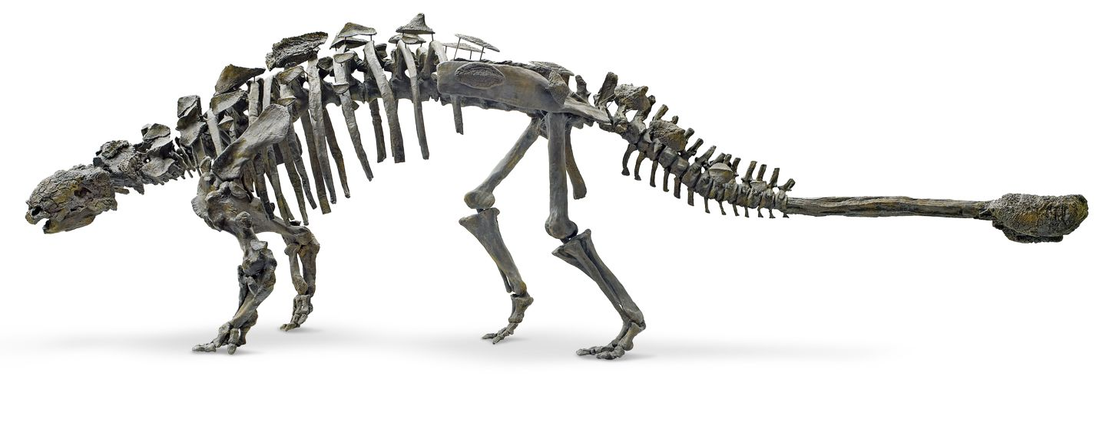
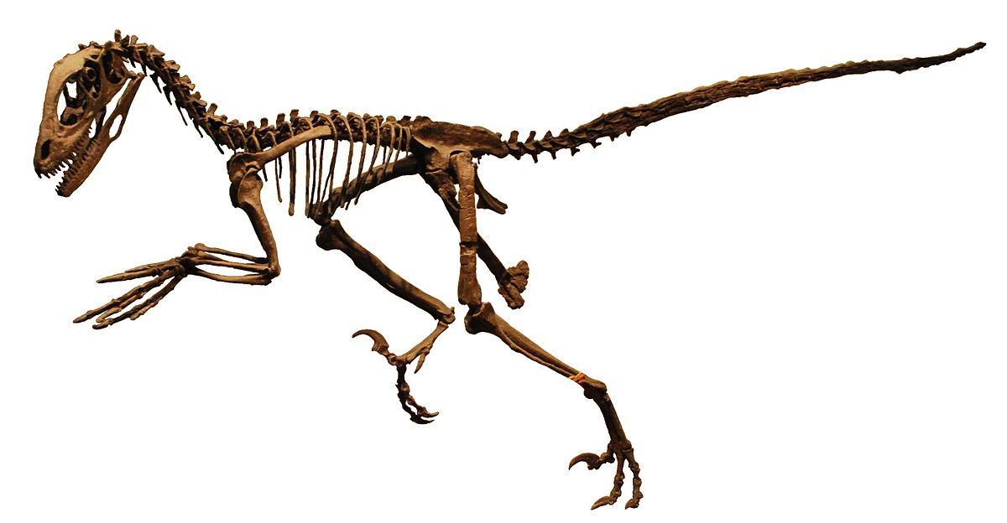
What is linear regression?
How do we quantify this relationship?
When m = 0 we have a flat line
When c = 0 we have a line that passes through (0,0).
intercept
y = m x + c
gradient

Slide 7
What is linear regression?
How do we quantify this relationship?
m
y = m x + c
c = 0 m = (1000-0)/(25-0)
c
y = 40 x + 0

Slide 8
What is linear regression?
How do we quantify this relationship?
y = m x + c
c = 0 m = (1000-0)/(25-0)
y = 40 x + 0
Evaluate the error over the data points

Slide 9
Observation variable
Explanatory variable

Slide 10
Randomly select a training set

Slide 11
SSE
Try different values of (m, c) and evaluate the sum squared error (SSE):
∑ ( (y_{pred} – y_{observed})² )
(here we fix c to the true value and just look at varying m)
m

Slide 16
This model is slightly worse than the previous one

Slide 18
What is linear regression?
Learn parameters (c, m) that minimize an error (here we used SSE)
In this example we iterated over values of m
Is actually analytically tractable (can solve it to find the value in terms of an equation)
Can predict the values of y* at new location x* (forecasting/decision making)
In this case the best model (minimizing SSE) doesn’t do so well for larger dinosaurs

Slide 19
Beyond linear regression
m
c
R PSEUDOCODE
y = m x + c
lrfit <- train(y~., x, method = "lm")

Slide 20
Polynomial regression
y = m₁ x² + m₂ x + c
R PSEUDOCODE
y = m₃ x³ m₂ x² + m₁ x + c
lrfit <- train(y~poly(x,degree=3), data, method = "lm")
y = ∑ m_{i} x^{i} + c

Slide 21
Polynomial regression
y = m₁ x² + m₂ x + c
Note: observation data is nonlinear … but we are using a linear model
Observations= (x,x²,x³,…,x^{i}) are fixed input variables
Our model for y is a linear combination of input variables
Parameters = (m₁ , m₂ , … , m_{n} , c) are optimised
y = m₃ x³ m₂ x² + m₁ x + c
y = ∑ m_{i} x^{i} + c

Slide 22
`
Multiple explanatory variables
Dinosaur length (m)
R PSEUDOCODE
z = m₁ x + m₂ y + c
lrfit <- train(z ~ x + y, data, method = "lm")
Our model for z is a linear combination of input variables

Slide 23
`
Multiple explanatory variables

Slide 24
`
Multiple explanatory variables

Slide 25
`
Multiple explanatory variables

Slide 26
`
Multiple explanatory variables
SSE
m₂
m₁
z = m₁ x + m₂ y + c

Slide 27
`
Multiple explanatory variables
SSE
m₂
m₁
z = m₁ x + m₂ y + c

Slide 28
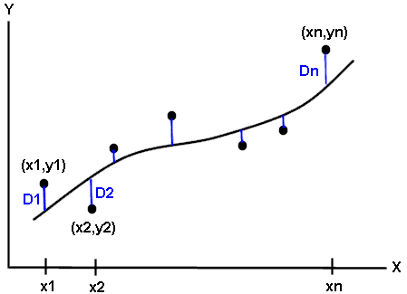
Recap: evaluating performance
Split the data:
Training set / test set
Calculate appropriate metric e.g. sum squared error:
SSE = ∑_{i} (y_{pred} – y_{i})²
Use the SSE on test set to pick which model is the best model
Too simple a model won’t have the descriptive power to explain the observations (underfitting)
Too complex a model will be able to describe the training data very well, but won’t generalise to the test data (overfitting)

Slide 29
Evaluating performance

Slide 30
Evaluating performance

Slide 31
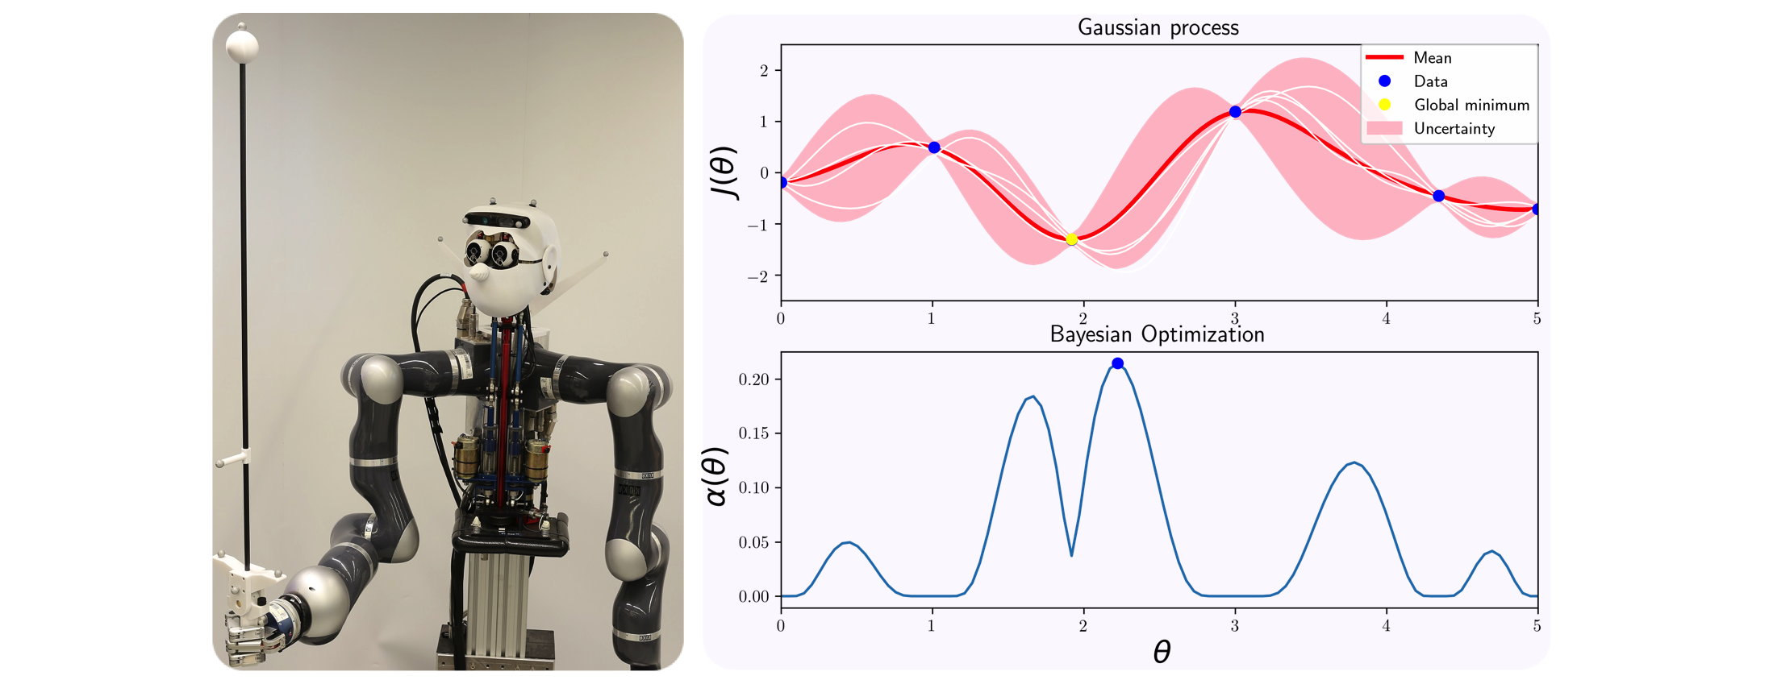
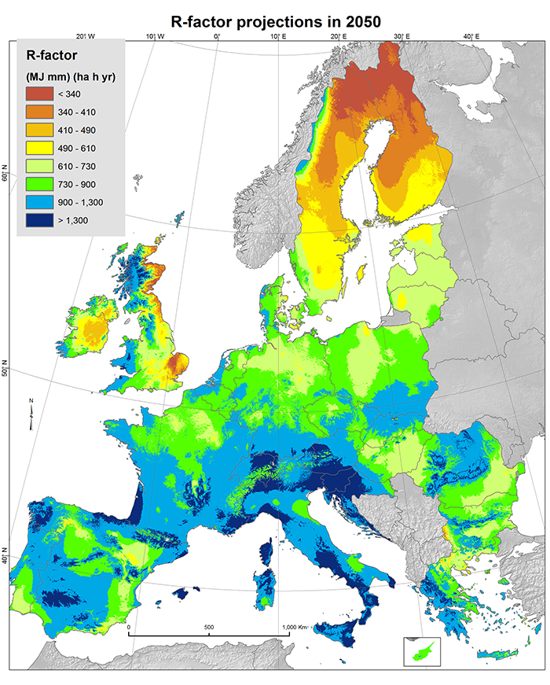
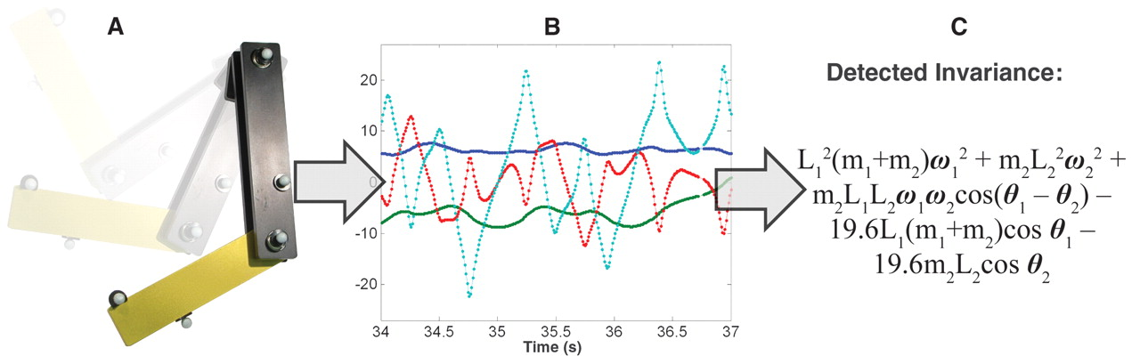
Some applications of regression
Learn to control a robot’s movement
Spatial predictions and forecasting
Rediscovering laws of physics

Slide 32
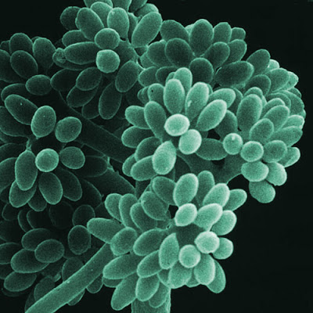
Tasks
In Section 10.1 we use linear regression to analyse Arabidopsis thaliana gene expression time series data following inoculation with the necrotrophic fungus Botrytis cinerea

Slide 33
Tasks
In Section 10.1 we use linear regression to analyse Arabidopsis thaliana gene expression time series data following inoculation with the necrotrophic fungus Botrytis cinerea
Open task. Look at the data!
Fit a simple linear regression model
Predict values at intermediate locations
Fit more complex models
Use sum squared errors on held out data to identify the best model
Main task: (as a team) identify an interesting looking gene and use linear models to understand (quantify) the behaviour over time. Write one or two paragraphs about the dataset and the methods you have used (as though you were writing a methods section for a paper)
Stop at section 10.2
Gene marker
time

Slide 35
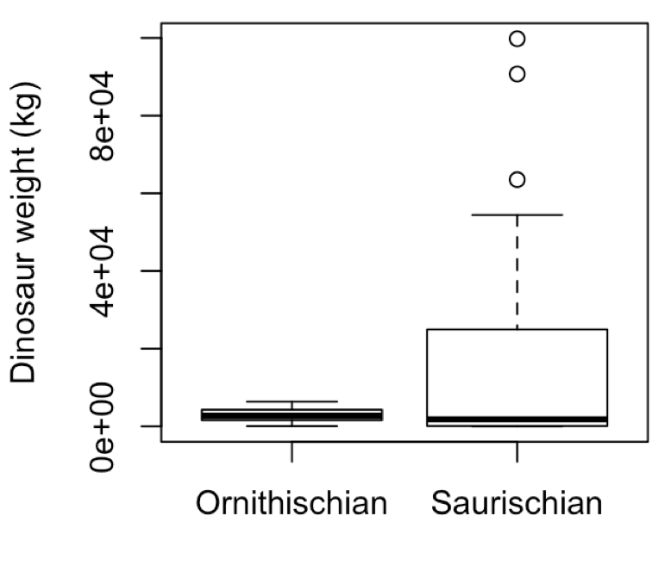
Logistic regression
Logistic regression
Is there a relationship between a dinosaur’s size and its (sub)order? Can we predict the the dinosaurs order given just measurement of its size?

Slide 36
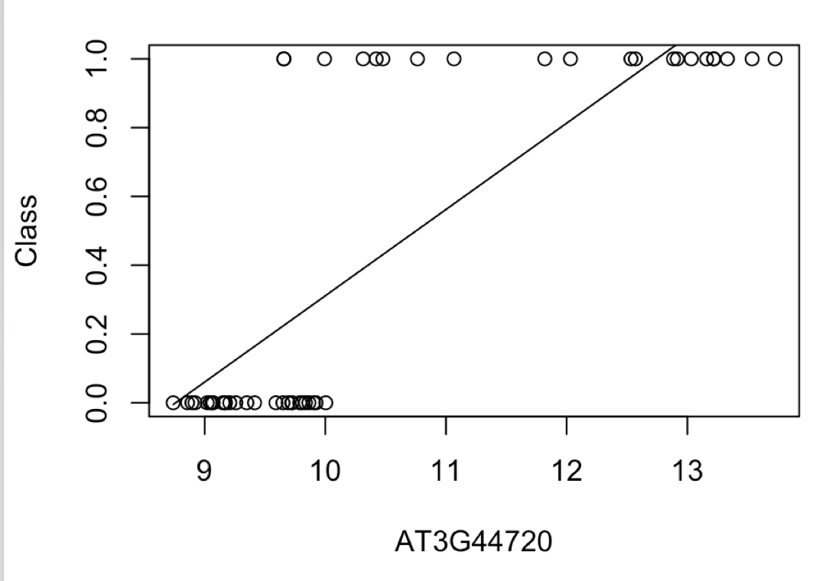
Logistic regression
Explanator variable x is continuous but we have binary valued outputs, y
Linear (polynomial) regression is no good!
Need a model that correctly accounts for the type of data we have
Suborder
Dinosaur weight

Slide 37
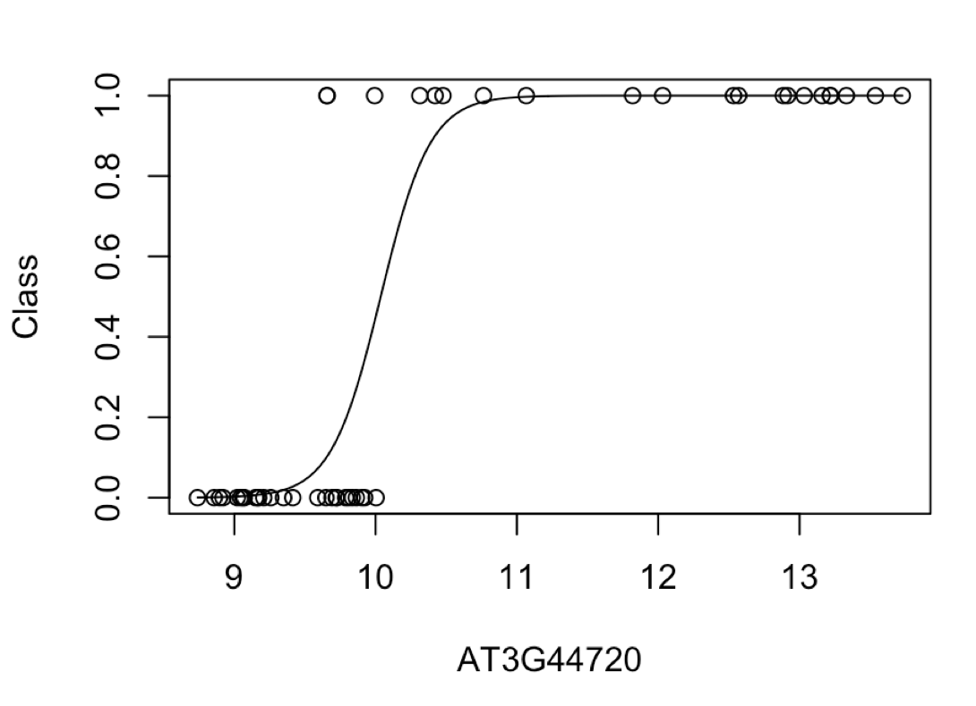
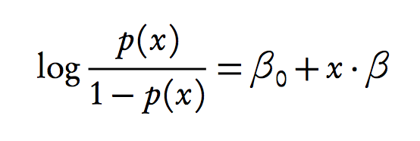
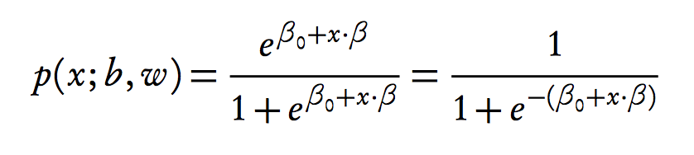
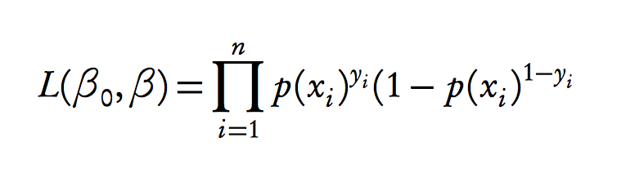
Logistic regression
Model probability of success
Solve for x
Likelihood
R PSEUDOCODE
lrfit <- train(y ~ ., data, method="glm", family="binomial")
Using held out data find parameters that maximises this
likelihood

Slide 38
Logistic regression
Model probability of success
Solve for x
Likelihood
Using held out data find parameters that maximises this
likelihood

Slide 39
Logistic regression
Model probability of success
Solve for x
Likelihood
Using held out data find parameters that maximises this
likelihood

Slide 40
Logistic regression
Model probability of success
P(y_{i}=1) = 0.51
Solve for x
Likelihood
Using held out data find parameters that maximises this
likelihood

Slide 41
Logistic regression
Model probability of success
P(y_{i}=1) = 0.91
Solve for x
Likelihood
Using held out data find parameters that maximises this
likelihood

Slide 42
Logistic regression
Model probability of success
P(y_{i}=1) = 0.91
Solve for x
Likelihood
x = (x₁, x₂, x₃, …, x_{n-1}, x_{n})
Using held out data find parameters that maximises this
likelihood
y = (0, 0, 1, …, 1, 1)
L = p(y₁=0) * p(y₂=0) * p(y₃=1) * … * p(y_{n}=1) * p(y_{n}=1 )
Give and value of beta0 and beta1 what’s the probability we see the sequence of data y = (y₁,…,y_{n})

Slide 43
Logistic regression
Model probability of success
Solve for x
Likelihood
Other values for betas?
Using held out data find parameters that maximises this
likelihood

Slide 44
Logistic regression
Model probability of success
Solve for x
Likelihood
Using held out data find parameters that maximises this
likelihood

Slide 45
Recap: evaluating performance
Output is a 0 or a 1. Evaluating using sum of squared error is a poor choice for performance.
Count number of correct/incorrect classifications.
True positive: Predict y = 1, observation y = 1.
True negative: Predict y = 0, observation y = 0.
False positive: Predict y = 1, observation y = 0.
False negative: Predict y = 0, observation y = 1.
Plot false positive rate (FPR) versus true positive rate (TPR):
TPR = TP/(TP+FN)
FPR = FP/(FP+TN)
Area under the curve (AUC)
Precision-recall (PR) curve

Slide 46
Tasks
As well as measuring gene expression we also have a measure of infection status (binary data)
Use logistic regression to look for marker genes that are indicative of infection status (Section 10.2)
Main task: As before the main task is to use logistic regression to identify marker genes predictive of infection status. Write what what you did

Slide 47


Slide 48
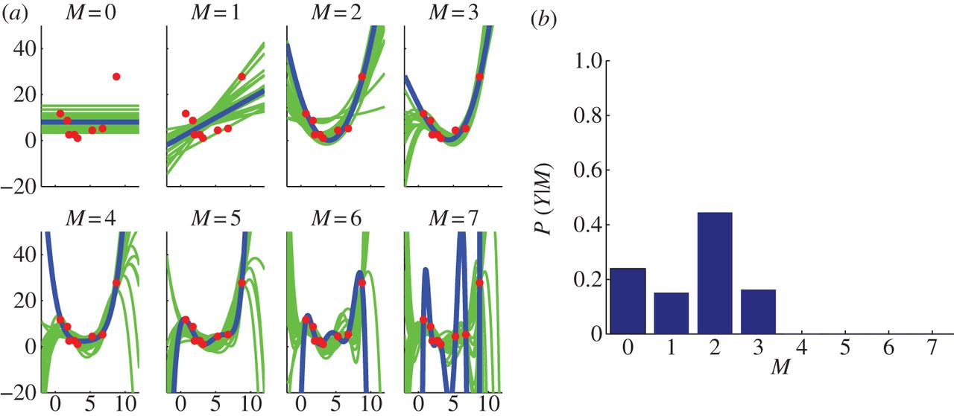
(Bayesian) polynomial regression
R PSEUDOCODE
lmfit <- lm(y~poly(x,degree=4), data)
simulate <- coef(sim(lmfit))
paramsamp <- head(simulate,10)

Slide 49
Hyperparameters
Use marginal likelihood to select optimal hyperparameters:
Grid search
Gradient optimisation

